Slide 1


COURSE
GUIDER AGENT
AI & EMERGING TECHNOLOGIES
TEAM WIZARDS

Slide 2

Problem Statement
📌 Current Challenges Faced by Learners:
Confusion on where to start for a specific course.
Lack of a structured roadmap and prerequisite guidance.
Difficulty in finding relevant tools, job roles, and career paths.
Staying updated with the latest industry trends is challenging.
⚠️ Result: Wasted time, scattered resources, and inefficient learning.

Slide 3

Solution – Course Guider Agent
✅ What is Course Guider Agent?
A group of AI-driven agents built with n8n that:
Provides detailed roadmaps for mastering any course.
Recommends essential tools and skills to focus on.
Suggests relevant job opportunities based on the course.
Accesses web search to fetch the latest trends & news.
🌟 Future Plans: Adding job scraping functionality for direct job listings.

Slide 4



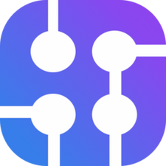
How to Build...?
🚀 Building the Course Guider Agent
1️⃣ Use n8n for Workflow Automation – Orchestrates the entire process, from query processing to AI responses.
2️⃣ AI Model: Groq's DeepSeek R1 – Generates roadmaps, tool recommendations, and job role mappings.
3️⃣ Storage: Supabase – Stores user queries, responses, and learning progress for better tracking.
4️⃣ Web Search: SerpAPI – Fetches real-time job listings and latest industry trends.
📌 Simple, Scalable, and AI-Driven! 🚀

Slide 5
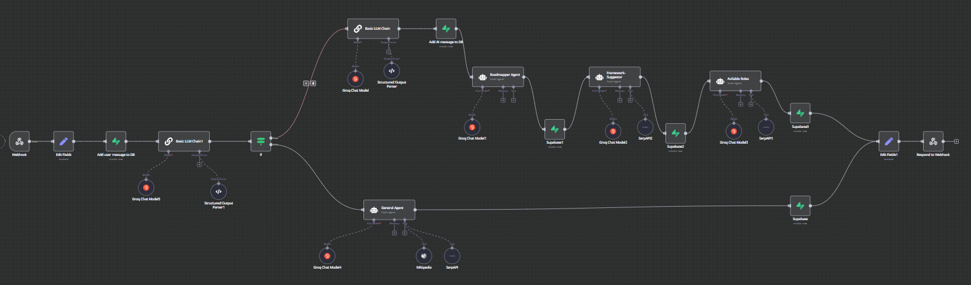
🚀 Approach
1️⃣ Query Classification – The agent analyzes user queries to determine whether they relate to learning a course or general knowledge.
2️⃣ Roadmap Creation – Uses an AI-powered Roadmapper Agent to generate structured learning paths based on course & duration.
3️⃣ Tools & Framework Suggestion – The Framework-Suggestor Agent provides essential tools & technologies required for mastery.
4️⃣ Job Role Mapping – The Available Roles Agent maps each course to relevant industry job roles.
5️⃣ Web Search & Trend Analysis – SerpAPI is used to fetch real-time job listings, industry trends, and latest developments.
6️⃣ Future Expansion – Planning automated job scraping for more accurate and direct job listings.

Slide 6
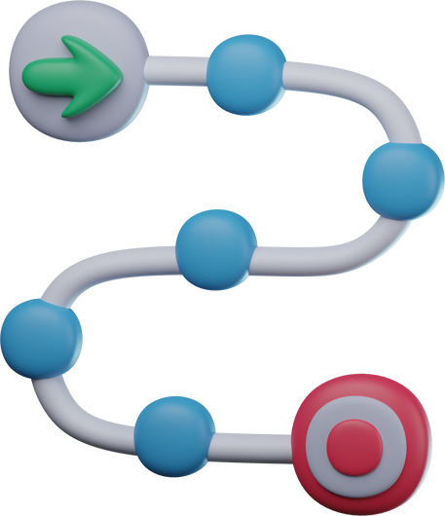



Features
Roadmap Generation
Tools Recommendations
Job Roles Suggestion
Access to Web & Wikipedia
AI-driven structured learning plans for any course.
Identifies essential technologies and frameworks.
Maps learning paths to relevant industry job roles.
Provides real-time updates on latest trends and news.

Slide 7

IMPACT
🌍 How Course Guider Agent Helps Learners:
Saves time & effort by providing structured learning paths.
Helps learners stay updated with industry trends & insights.
Increases career readiness by suggesting relevant job roles.
Bridges the gap between learning and real-world opportunities.
📈 End Result: Smarter learning, better opportunities, and a clear career roadmap.

Slide 8
